Slide 1

BASIC OF CIVIL ENGINEERING (TCE 101)
UNIT- 2 Lect 3
.

Slide 2
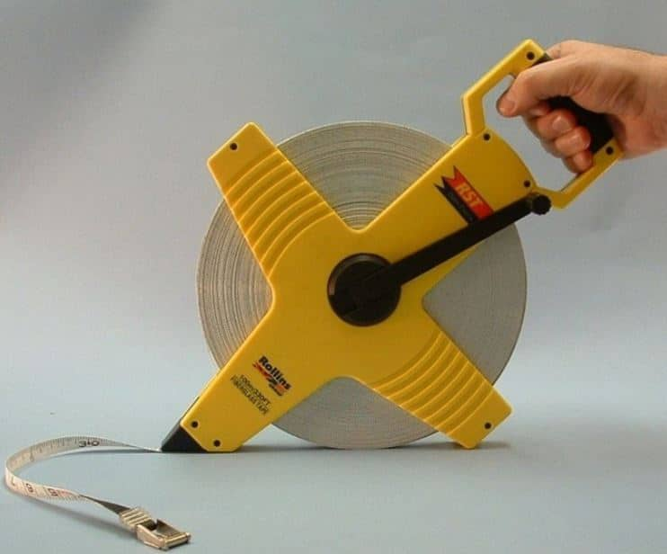

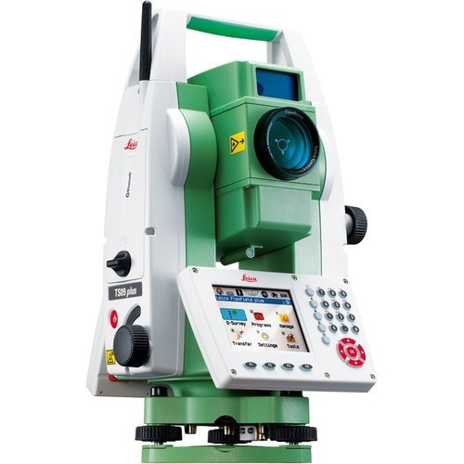
Linear Measurements
DEFINITION AND TYPES
In engineering survey, the linear horizontal distance is to be measured to complete a survey. The measurement of this linear horizontal distance between two points on the earth surface is known as linear measurement. Linear measurement can be achieved by various instruments. The measurement type can be divided as
Direct measurement methods (using chain, tapes)
Optical measurement methods (using tacheometer)
Electronic distance measurement method

Slide 3
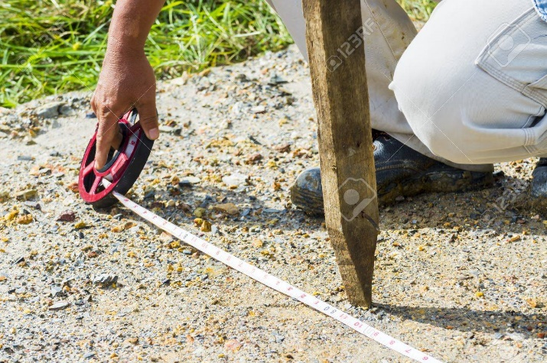
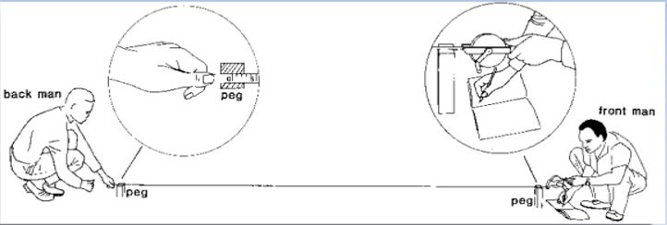
Linear Measurements using tapes
MEASURING TAPES
Tapes are used for more accurate measurements. Tapes are classified based on the materials of which they are made such as:
Cloth or linen tape
Fibre tape
Metallic tape
Steel tape
Invar tape

Slide 4
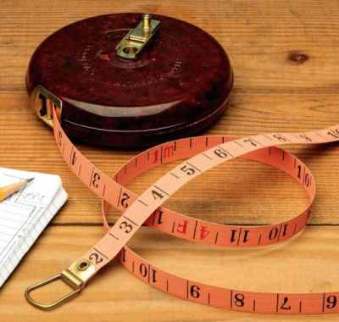
Linear Measurements using tapes
TYPES OF MEASURING TAPES
CLOTH OR LINEN TAPE
made of closely woven linen
width of the strip is about 12 to 16 mm
available in different lengths such as 10m, 20m, 30m, and 50m
light in weight and easy to handle.
may shrink when exposed to water and also elongate when pulled.
not suitable for accurate surveying measurements.
generally used for measuring offsets and for ordinary works.

Slide 5
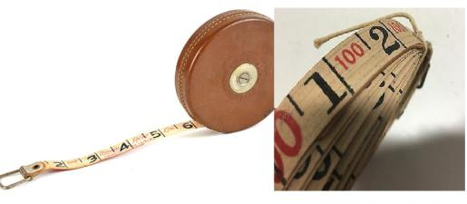
Linear Measurements using tapes
TYPES OF MEASURING TAPES
METALLIC TAPE
improved version of linen tape.
Brass or copper made wires are used as reinforcement for the linen material.
more durable than normal linen tape.
available in different lengths of 2m, 10m, 15m, 20m, 30m, and 50m.
used for survey works such as topographical survey works where minor errors are not taken into consideration.

Slide 6
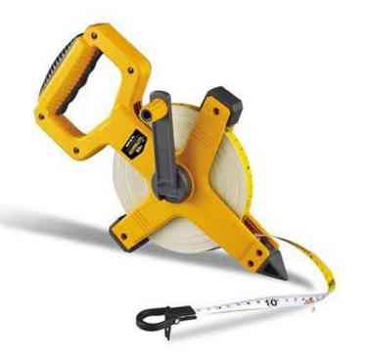
Linear Measurements using tapes
TYPES OF MEASURING TAPES
FIBRE TAPE
made of glass fibers coated with PVC.
light in weight and flexible.
available in lengths of 5m, 10m, 20m, 30m, and 50m
may stretch when subjected to tension. Hence, these are not suitable for accurate surveying works.
are recommended in place of steel tapes where it is essential to take measurements in the vicinity of electric fences and railway lines, etc.

Slide 7
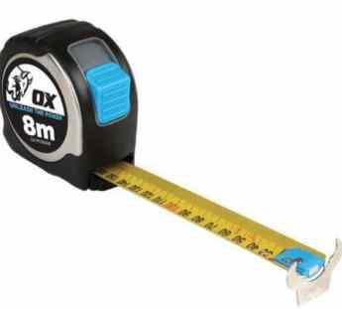
Linear Measurements using tapes
TYPES OF MEASURING TAPES
STEEL TAPE
made of steel or stainless steel.
consists of a steel strip of 6mm to 16mm wide.
available in lengths of 1m, 5m, 8m, 10m, 20m, 30m and 50m.
Meters, decimeters, and centimeters are graduated in the steel strip.
The tape is withdrawn from the case by using a hand during measuring and it is rewound into the case by just pressing button provided on the case.
not flexible and are suitable for measuring leveled surfaces only.
may corrode easily when exposed to moisture and to prevent this tape, it should be cleaned and oiled after every use.
generally used for standardizing chains, measurements of construction works, etc.

Slide 8
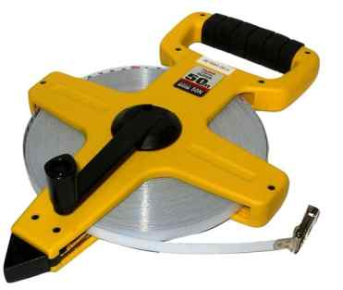
Linear Measurements using tapes
TYPES OF MEASURING TAPES
INVAR TAPE
made of an alloy which consists of 36% of nickel and 64% of steel.
contains a 6mm wide strip and is available in different lengths of 30m, 50m, 100m.
The coefficient of thermal expansion of invar alloy is very low hence not affected by changes in temperature.
used for high precision works in surveying such as baseline measurement, triangulation surveys, etc.
expensive than all the other types of tapes.
should be handled with care otherwise bends or kinks may be formed.

Slide 9
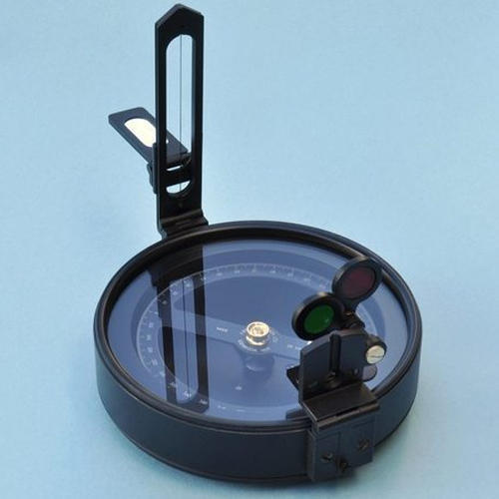
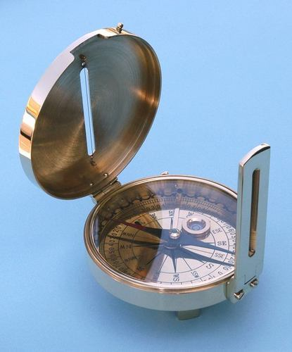
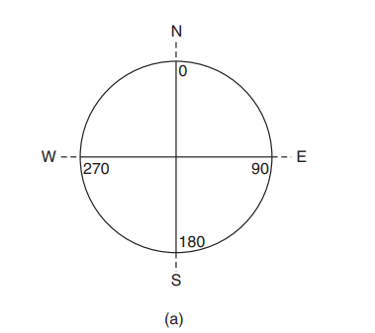
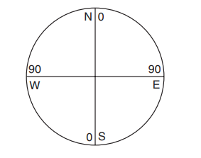
Angular Measurement
Points on ground or on map are related to each other through horizontal distance and horizontal angle (direction).
Horizontal angular measurement are made between survey lines to determine angle between the lines.
Horizontal angle is difference between two measured directions.
When the area to be surveyed is large, angles or direction is essential to be observed while drawing survey lines. Such angular measurements are done using COMPASS.
Types of Compass
Prismatic Compass
Surveyor Compass

Slide 10
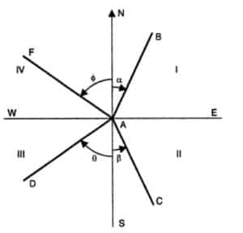
Angular Measurement
Bearing
Bearing is defined as the acute angle that is measured between the reference meridian and the given line.
The line is measured either from the north or south towards east or west that would give an angle less than 360 degrees. The angle is represented by N or S first followed by angle value and E or W direction, For example, N60E.
From the figure, the bearing of line AB is ? which is less than 90 degrees as it lies in first quadrant NE.

Slide 11
Angular Measurement
Bearing
Bearing of line:
The bearing of a line is the horizontal angle made by the line with a selected reference line called the meridian. There are two types of bearings.
Magnetic Bearing: The direction indicated by a freely supported magnetic needle unaffected by local attractive forces, is called the magnetic meridian. The angle between any line and magnetic meridian is called magnetic bearing or simply bearing.
The Bearing: The line joining the geographical north and south poles is known as the true meridian or geographical meridian. The angle between any line and the true meridian is called true bearing of azimuth.

Slide 12
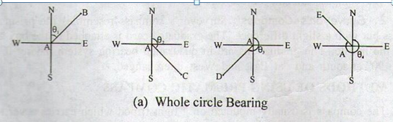
Angular Measurement
Bearing
DESIGNATION OF BEARING
  The whole circle bearing system
  Quadrantal bearing system, or reduced bearing system
  The whole circle bearing system:
In this system the bearing of a line is measured with north in clockwise direction. The value of the bearing thus varies from 0º to 360º.

Slide 13
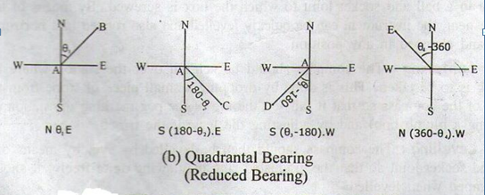
Angular Measurement
Bearing
  Quadrantal bearing system
    In this system the bearing of a line measured from either the north or the south, clockwise or counter clockwise whichever is nearer the line, towards the east or west

Slide 14
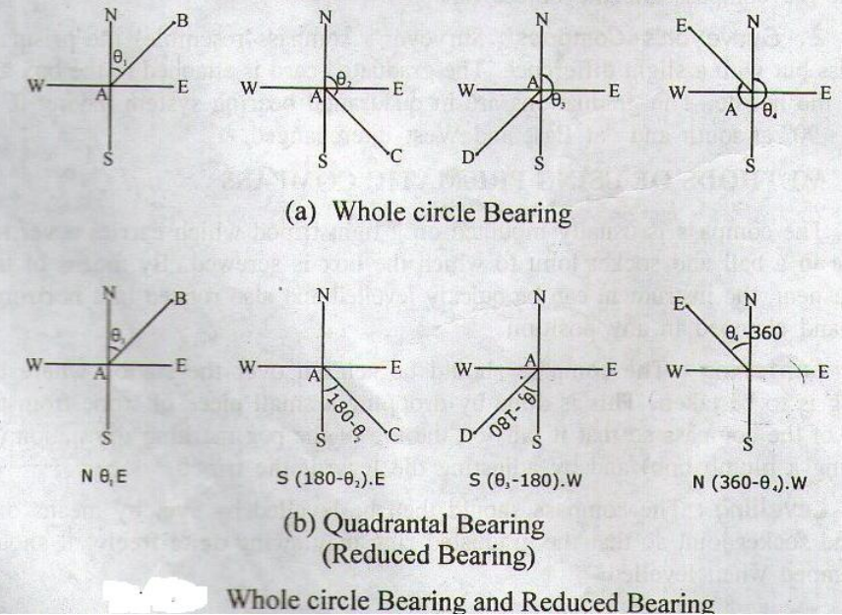
Angular Measurement
Bearing

Slide 15
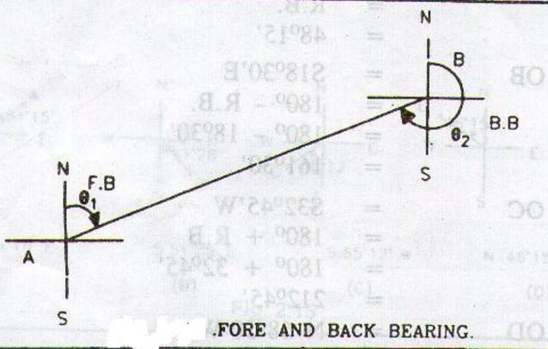
Angular Measurement
Bearing
  Fore bearing and back bearing In compass surveying, two bearings are observed for each line, one from each end of the line.
  The bearing of a line in the direction of the progress of survey is called fore bearing while the bearing measured in the opposite direction is known as back bearing.
  For e.g. the bearing of line AB taken from the point A is the fore bearing of ine AB and the bearing from
  point B is back bearing of the
  line AB

Slide 16
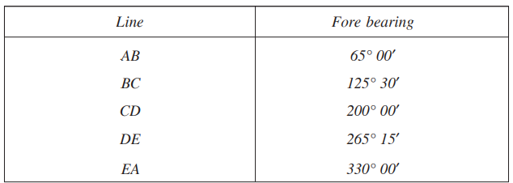
Angular Measurement
COMPUTATION OF ANGLES
  In a closed traverse the following bearings were observed with a compass. Calculate the interior angles

Slide 17
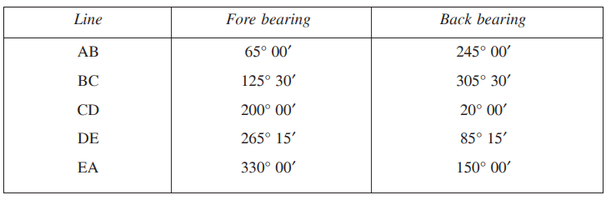
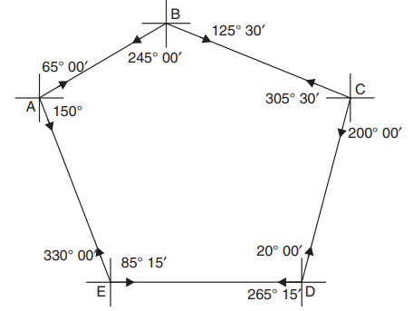
Angular Measurement
Bearing
Back bearings of all the lines may be worked out and noted on the figure. Then calculation of interior angles can be easily carried out.

Slide 18
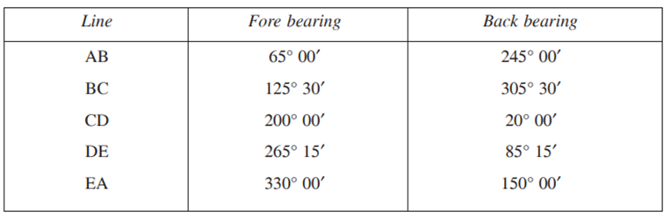
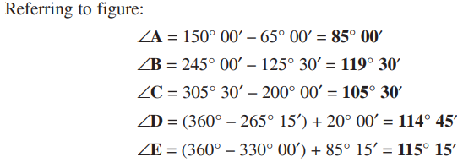
Angular Measurement
Bearing
In a pentagon sum of interior angles = (2n – 4) × 90 = (2 × 5 – 4) × 90 = 540°

Slide 19
Thank you

